Slide 1

Resources for the Energy Sector
Commission Chair – Ron Black
Assistant County Manager of Ops – Corey Needham

Slide 2

Lea County Government – Resources of the Energy Sector
Tax Incentives
Emergency Management and Fire
Transportation

Slide 3
Lea County Industrial Revenue Bonds
An incentive offered by municipalities & counties to stimulate expansion and relocation of commercial and industrial projects
Permitted pursuant to Industrial Revenue Bond Act
Variety of eligible uses: warehouses, manufacturing facilities, land, buildings, equipment, professional fees,
IRB Programs allow for a possible reduction in tax obligations
An mechanism to raise capital financing
Impact: increase in employment, economic diversity, and capital investment
Municipality or County must approve a “inducement resolution” and applicable ordinance to approve the project
The municipality or County (the issuing agency) is not responsible for the bond repayment or debt of the company
In addition to property tax exemption, personal property in facilities is exempt from gross receipts and compensating tax.

Slide 4
Lea County Industrial Revenue Bonds
Total: $6,330,000,000 issued
Agave Energy
Akuo Energy USA
DCP Midstream
Wildcat Wind
Intrepid Potash
International Isotopes
Louisiana Energy Services
Impact: increase in employment, economic diversity, and capital investment

Slide 5
Emergency Management, Emergency Dispatch, Fire Departments
Emergency Operations and Hazard Mitigation Plan Development
Full scale, tabletop, and drill training and response to any organization or company in Lea County
State of the Art Emergency Operations Center located to provide support to any natural or man made disaster not only in Lea County, but is also the designated backup EOC for the State of New Mexico
Provides CPR, Oil and Gas, Fire, EMS, NIMS, Wildland Fire, and Safety training to each department in Lea County.
Have the ability to assist in this type of training to the oil and gas industry when requested

Slide 6


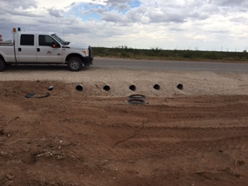
Transportation-
Roadways
Roadways
  1,223 miles of county maintained roadways
    724 miles are paved roadways
    $80 million have been allocated to roadway improvements in Lea County of the last 8 years
      Included paving, widening, and rebuilding over 140 miles of roadway
Direct and Primary County Roads for Oil and Gas Use:
37.5%
Roads that Provide Access to Primary O&G
Roadways – 31.7%
Road the Do Not Serve Oil and Gas:
30.8%

Slide 7
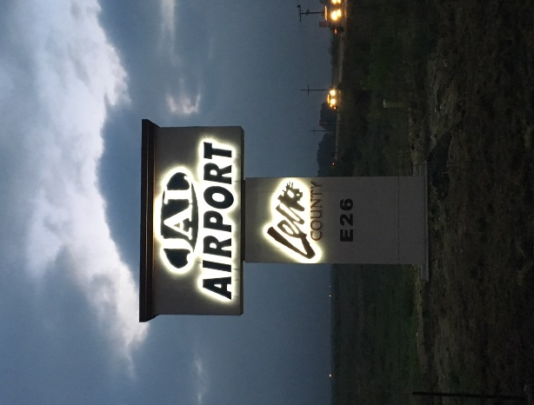


Transportation-
Airports Division
Lea County Airports
  Zip Franklin Memorial Airport (Lovington, NM)
    General Aviation
  Lea County Regional Airport (Hobbs, NM)
    Commercial Air Service with United Airlines
  Lea County Jal Airport (Jal, NM)
    General Aviation
Lea County Regional Airport
    3 Runways, 2 have been recently reconstructed
      Airport can service aircraft of Boeing 737 and equivalent
    ATCT, ILS, AWOS, Precision equipped runways
    Commercial Air Service with United Airlines from Houston Intercontinental Airport
      United Quick Pak service now available
        Items under 100lbs
        Parts or Items from Houston in 1 hour

Slide 8
Cooperation, Coordination, and Communication
Meet regularly with industries to find shared opportunities, areas for improvements and long term infrastructure requirements.
Ron Black
Lea County Board of Commissioners - Chairman
ronrblack@leacounty.net
Mike Gallagher
County Manager
mgallagher@leacounty.net
Corey Needham
Assistant County Manager of Operations
cneedham@leacounty.net

