Slide 1
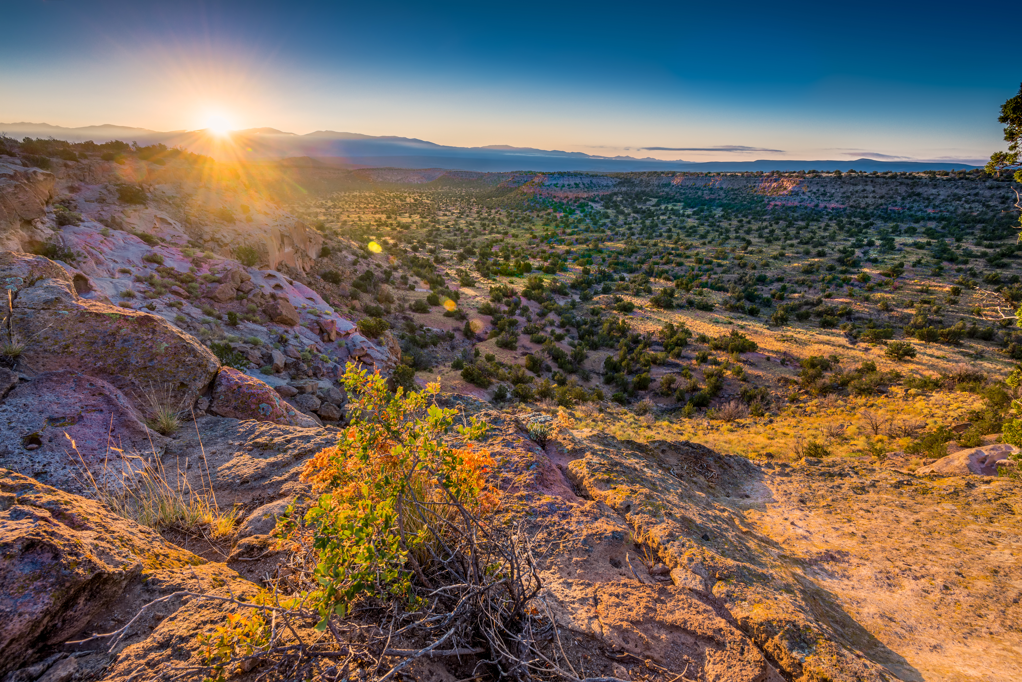
Chairman Cliff Brunson
2017 New Mexico EnergyPlex Conference

Slide 2
New Mexico is a National Leader in Energy Production
#5 in oil production
#8 in natural gas production
New Mexico should be proud to be a leader in producing energy for America!

Slide 3


Oil & Natural Gas drives New Mexico’s Economy
Royalties, taxes, and other revenue accounts for one-third of the state’s annual budget for schools, public safety, roads, and health care.
The industry is responsible for more than 100,000 New Mexico jobs.

Slide 4



In New Mexico…Permania!
“...oil companies…are piling into the Permian Basin, the oil-rich region straddling Texas and New Mexico that is the epicenter of the second wave of U.S. shale drilling.”
“…a rash of multibillion-dollar deals are flashing sparks of recovery in the shale fields of the Permian Basin straddling Texas and New Mexico.”
“The Permian Basin has now become the crown jewel of the world’s oil and gas industry.”
“The Permian Basin oil field in southeast New Mexico and west Texas first started producing shortly after World War I. But almost 100 years later, it seems to keep getting better, and may become the world’s biggest oil field.

Slide 5
Opportunities
SANTA FE
Governor Martinez has been a strong supporter of oil and natural gas since taking office in 2011, and her administration has prioritized regulatory efficiencies for oil and gas production.
WASHINGTON
President Donald Trump has made American energy security one of his top priorities, and his administration has prioritized policies to advance energy production and eliminate wasteful or unnecessary regulations proposed under the previous administration.

Slide 6
The BLM Challenge
BLM has consistently delayed issuing permits for the necessary gathering lines to collect gas at the wellhead and pipelines to transport that gas to market.
Rather than consume time with wasteful and redundant rules, BLM should clear the backlog of right-of-way applications to build pipelines and other infrastructure that would allow drilling operations to greatly reduce flaring.
This would reduce venting and flaring, which would lead to a boom in tax revenue for New Mexico, rather than pushing down a rule that will take millions in revenue out of New Mexico’s general fund.
The current administration has identified this and is taking appropriate steps to address efficiency in BLM operations and the flawed venting and flaring rule.

Slide 7
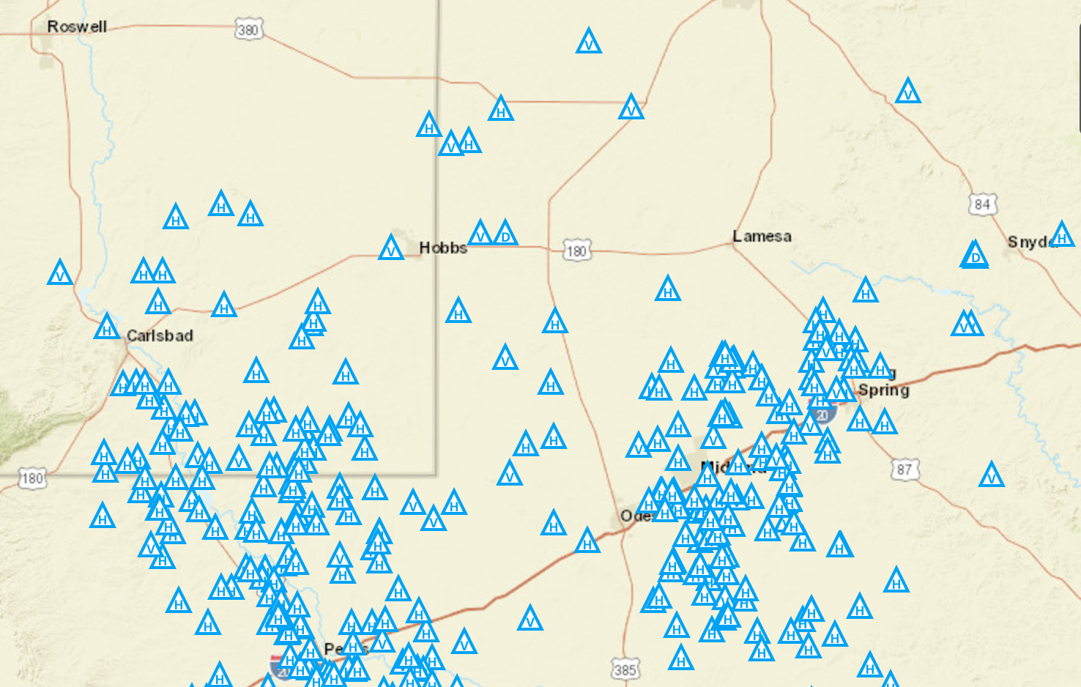
The BLM difference?
59 rigs
309 rigs
Compare New Mexico and Texas, and the BLM difference is more apparent. While permits are readily approved for non-federal land, much of New Mexico waits.

Slide 8
Your role and how NMOGA helps
About NMOGA
NMOGA represents the men and women of New Mexico who work hard every day to safely provide energy for our state and our nation. Our priority is to tell the story of energy in New Mexico, how it impacts communities, how it benefits our state, and how it drives our state’s economy.
Using the EnergyPlex voice
Make your voice heard on important issues facing our industry, both in Santa Fe and Washington. Your input is extremely valuable since it demonstrates there are a number of New Mexicans who support the industry.

Slide 9
A stronger economy.
A brighter future.

