Slide 1
Management of Produced Water in the EnergyPlex
New Mexico EnergyPlex Conference, June 28, 2017

Slide 2
Typical Permian Basin

Slide 3
Atypical Permian Basin
Hobbs, July, 2010

Slide 4
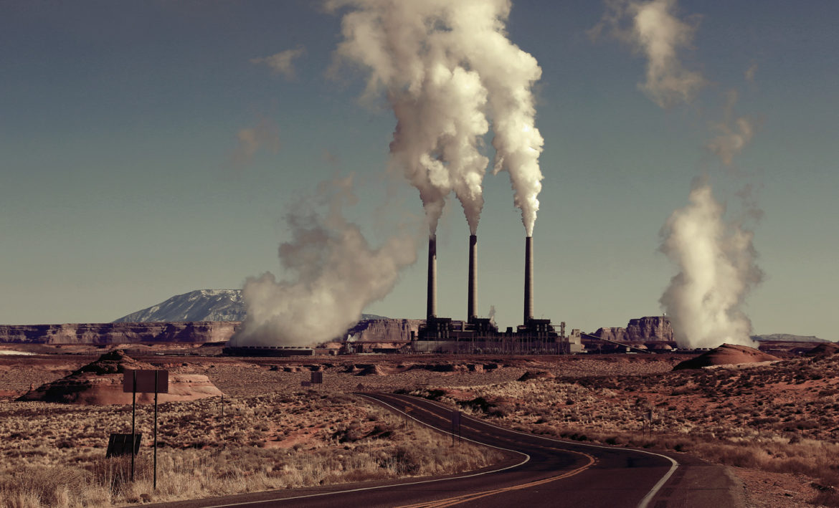
Reduced Water Availability
Ogallala Aquifer restrictions.
Increased demand on existing resources from many industries.
Depletions of existing freshwater supplies.
Increased water acquisition costs.

Slide 5
Produced Water Management
Potential for 1 bbpd produce water by 2020!

Slide 6
Technology and Disposal Changes
New technologies and improvements to existing technologies are available for treatment of produced water.
Potential alternatives for produced water disposal, but regulatory change is required
Mining
Animal feed irrigation
Surface water augmentation

Slide 7
Local Engineering Leader
Water Resources Expert for Lea County
Permitting and Advocacy
Infrastructure and Development
Easement Acquisition
Deep Local Ties, Experience, and Relationships
National Leader in Water and Wastewater Treatment
Pioneer in Water Recycling
Extensive Produced Water Management and Treatment Expertise
Solving complicated treatment issues

Slide 8
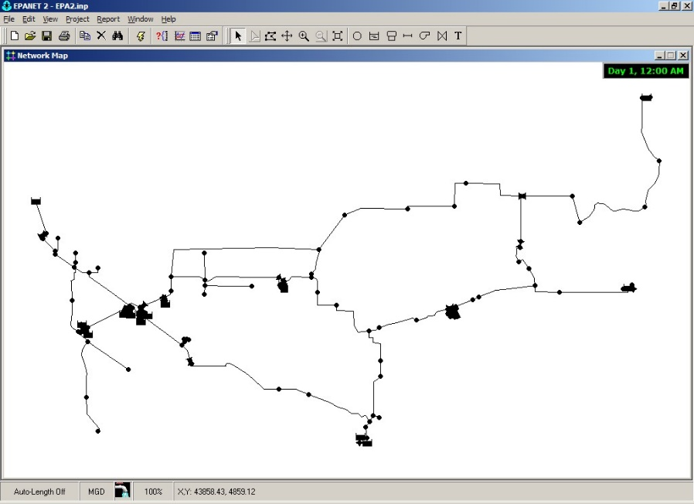
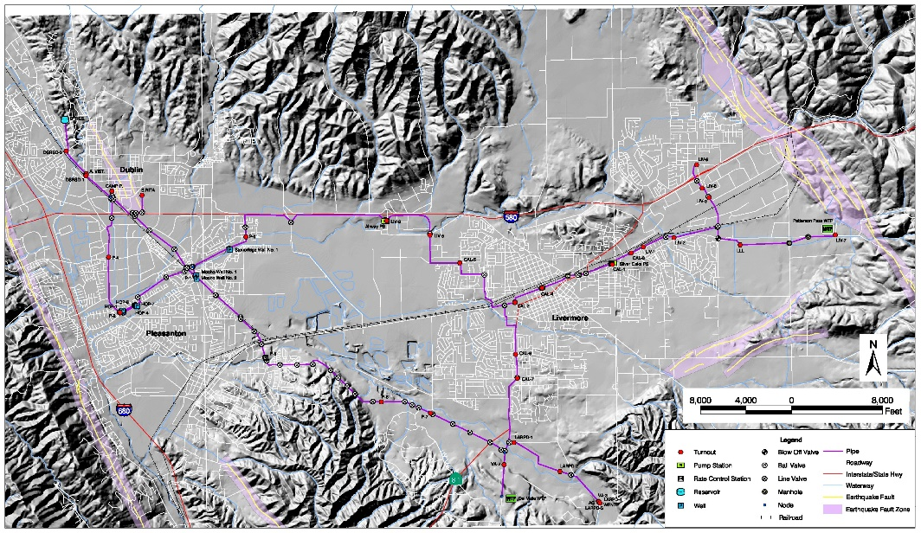
Centralized and Distributed Water Treatment
By centralizing treatment resources, infrastructure costs can be reduced
Produced water management can be improved and produced water transport reduced with planning

Slide 9
Treatment Systems
A mixture of central and satellite facilities can reduce impacts to community and to oilfield operations while saving significant total expenditure (TOTEX = CAPEX + OPEX)

Slide 10
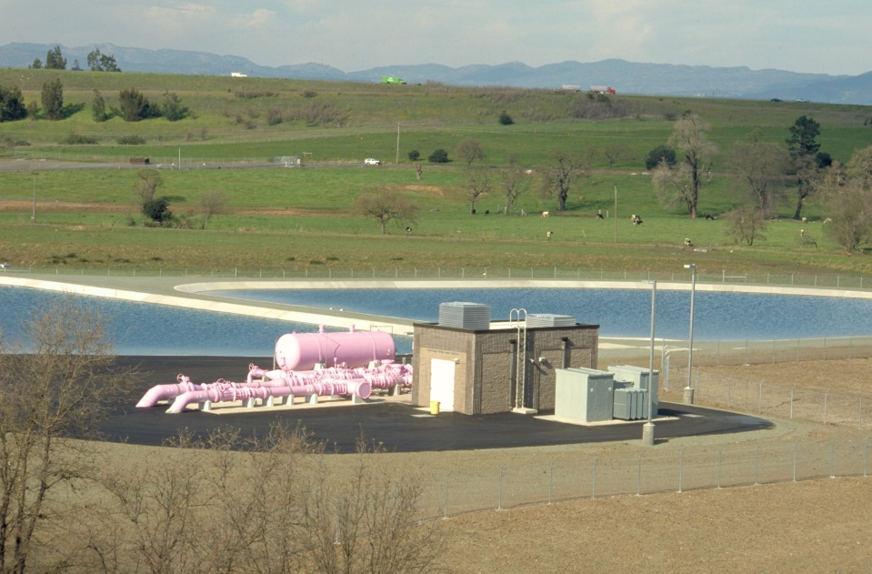
Partnerships for Management of Water
Lea County Economic Development Corporation (EDC) plays an integral role in this partnership.
Looking for O&G partnerships to help develop plans that are beneficial to everyone.
Can help identify water resources and disposal opportunities.

Slide 11
Timelines
Produced water planning and treatment is not a “sprint”, but a “long-distance race.”
Legislative/Political issues require careful collaboration
Design, procurement, construction
The time to start is… NOW

Slide 12
If you need to speak to somebody, or you would like to be part of this partnership…
Nathan Zaugg, P.E. Carollo Engineers 801-557-2832 nzaugg@carollo.com www.carollo.com
Russ Doss, P.E. Souder Miller & Associates 575-441-5956 russell.doss@soudermiller.com www.soudermiller.com

