Slide 1
Lea County EnergyPlex Summit
Clay Bateman
Vice President of New Mexico

Slide 2
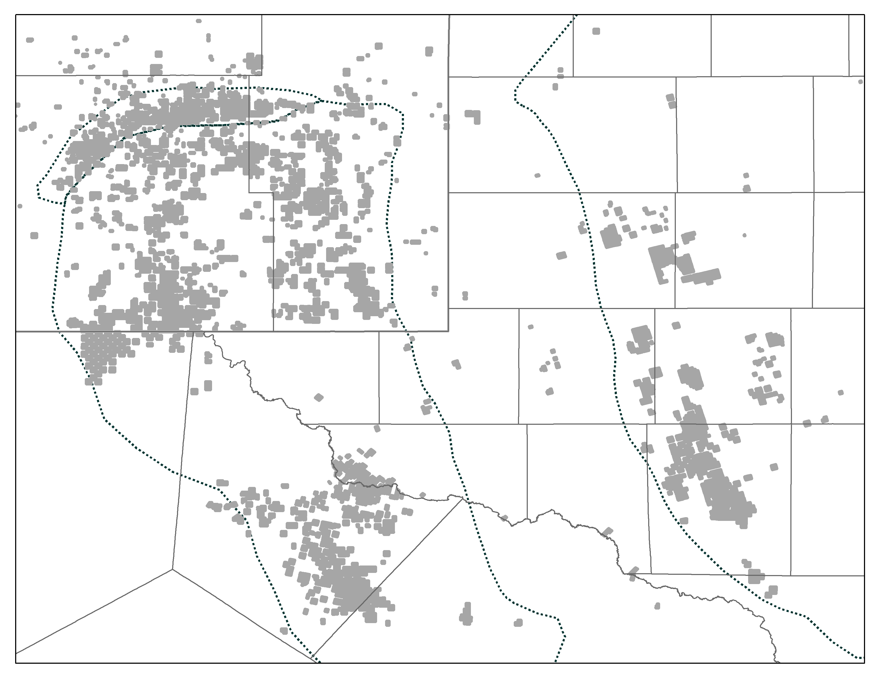
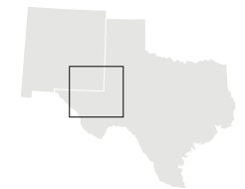
Concho Resources
Largest Pure-Play Permian Company
Premier Permian Assets
Leading exposure to the Permian Basin
~930,000 gross (600,000 net) acres
Four core areas benefit capital flexibility
Prolific growth platform
720 MMBoe estimated proved reserves
~8 BBoe of total resource potential, including proved reserves
>19,000 horizontal drilling locations
Current and future focus on New Mexico
No. 1 producer of oil and No. 3 producer of natural gas
One of the largest leaseholders
Operate the largest rig program
Investing $800-$900 million this year
New Mexico Shelf
Midland
Basin
Northern
Delaware
Basin
Southern
Delaware
Basin
CXO Acreage
Note: Acreage as of December 31, 2016, pro forma for year-to-date announced acquisitions and dispositions. Proved reserves and resource potential as of December 31, 2016, and excludes year-to-date announced acquisitions.

Slide 3
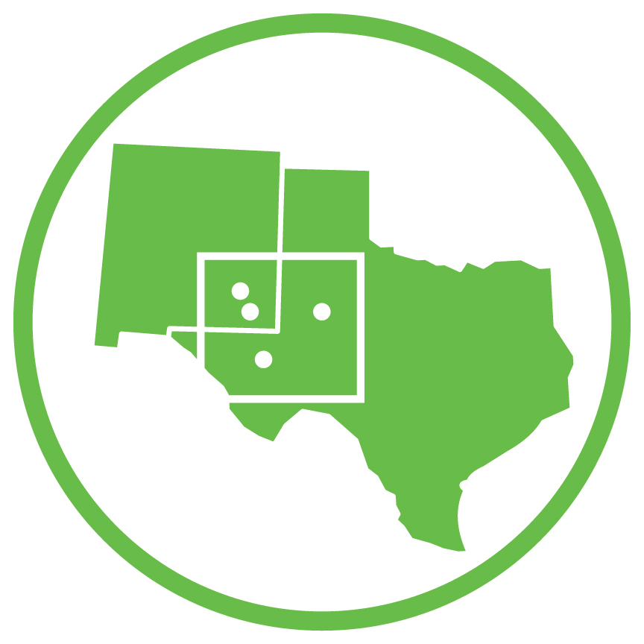


Driving Superior Capital Efficiency through Scale
Defining the Scale Advantage
Premier Permian Position
Size & Quality
High-quality assets, better well productivity, exceptional source of upside
Long lateral, manufacturing-style development
Drilling Machine
Large-Scale Program
More is better – drill more wells, generate more data, drive better outcomes
Economies of scale; utilization = cost advantage
Smart infrastructure investments protect the program and margins
Marketing strategy to capture the most value and takeaway assurance
Strong Financial Position
Conservative Leverage Profile
Peer-leading balance sheet
Strong financial position provides ultimate flexibility

Slide 4
2017 Capital Program
Capital-Efficient Growth & Value Creation
2017 Capital Program Allocation
Extending Efficiency Gains
Total capital program: $1.6bn to $1.8bn¹
~90% of capital directed to drilling and completion activity; 10% for infrastructure and other
Rig Count
21
Rigs in place to deliver on 2017 growth target
Consolidation increases program WI, led by Midland Basin
19
50% of capital program directed to New Mexico
D&C
Capital
Company-Wide Avg. Lateral Length per Well (ft.)
Drilling longer laterals across portfolio
70%+ of program to utilize multi-well pads
~20%
Targeting 21% to 25% Production Growth and 25% Oil Production Growth
¹Capital program excludes acquisitions.

Slide 5
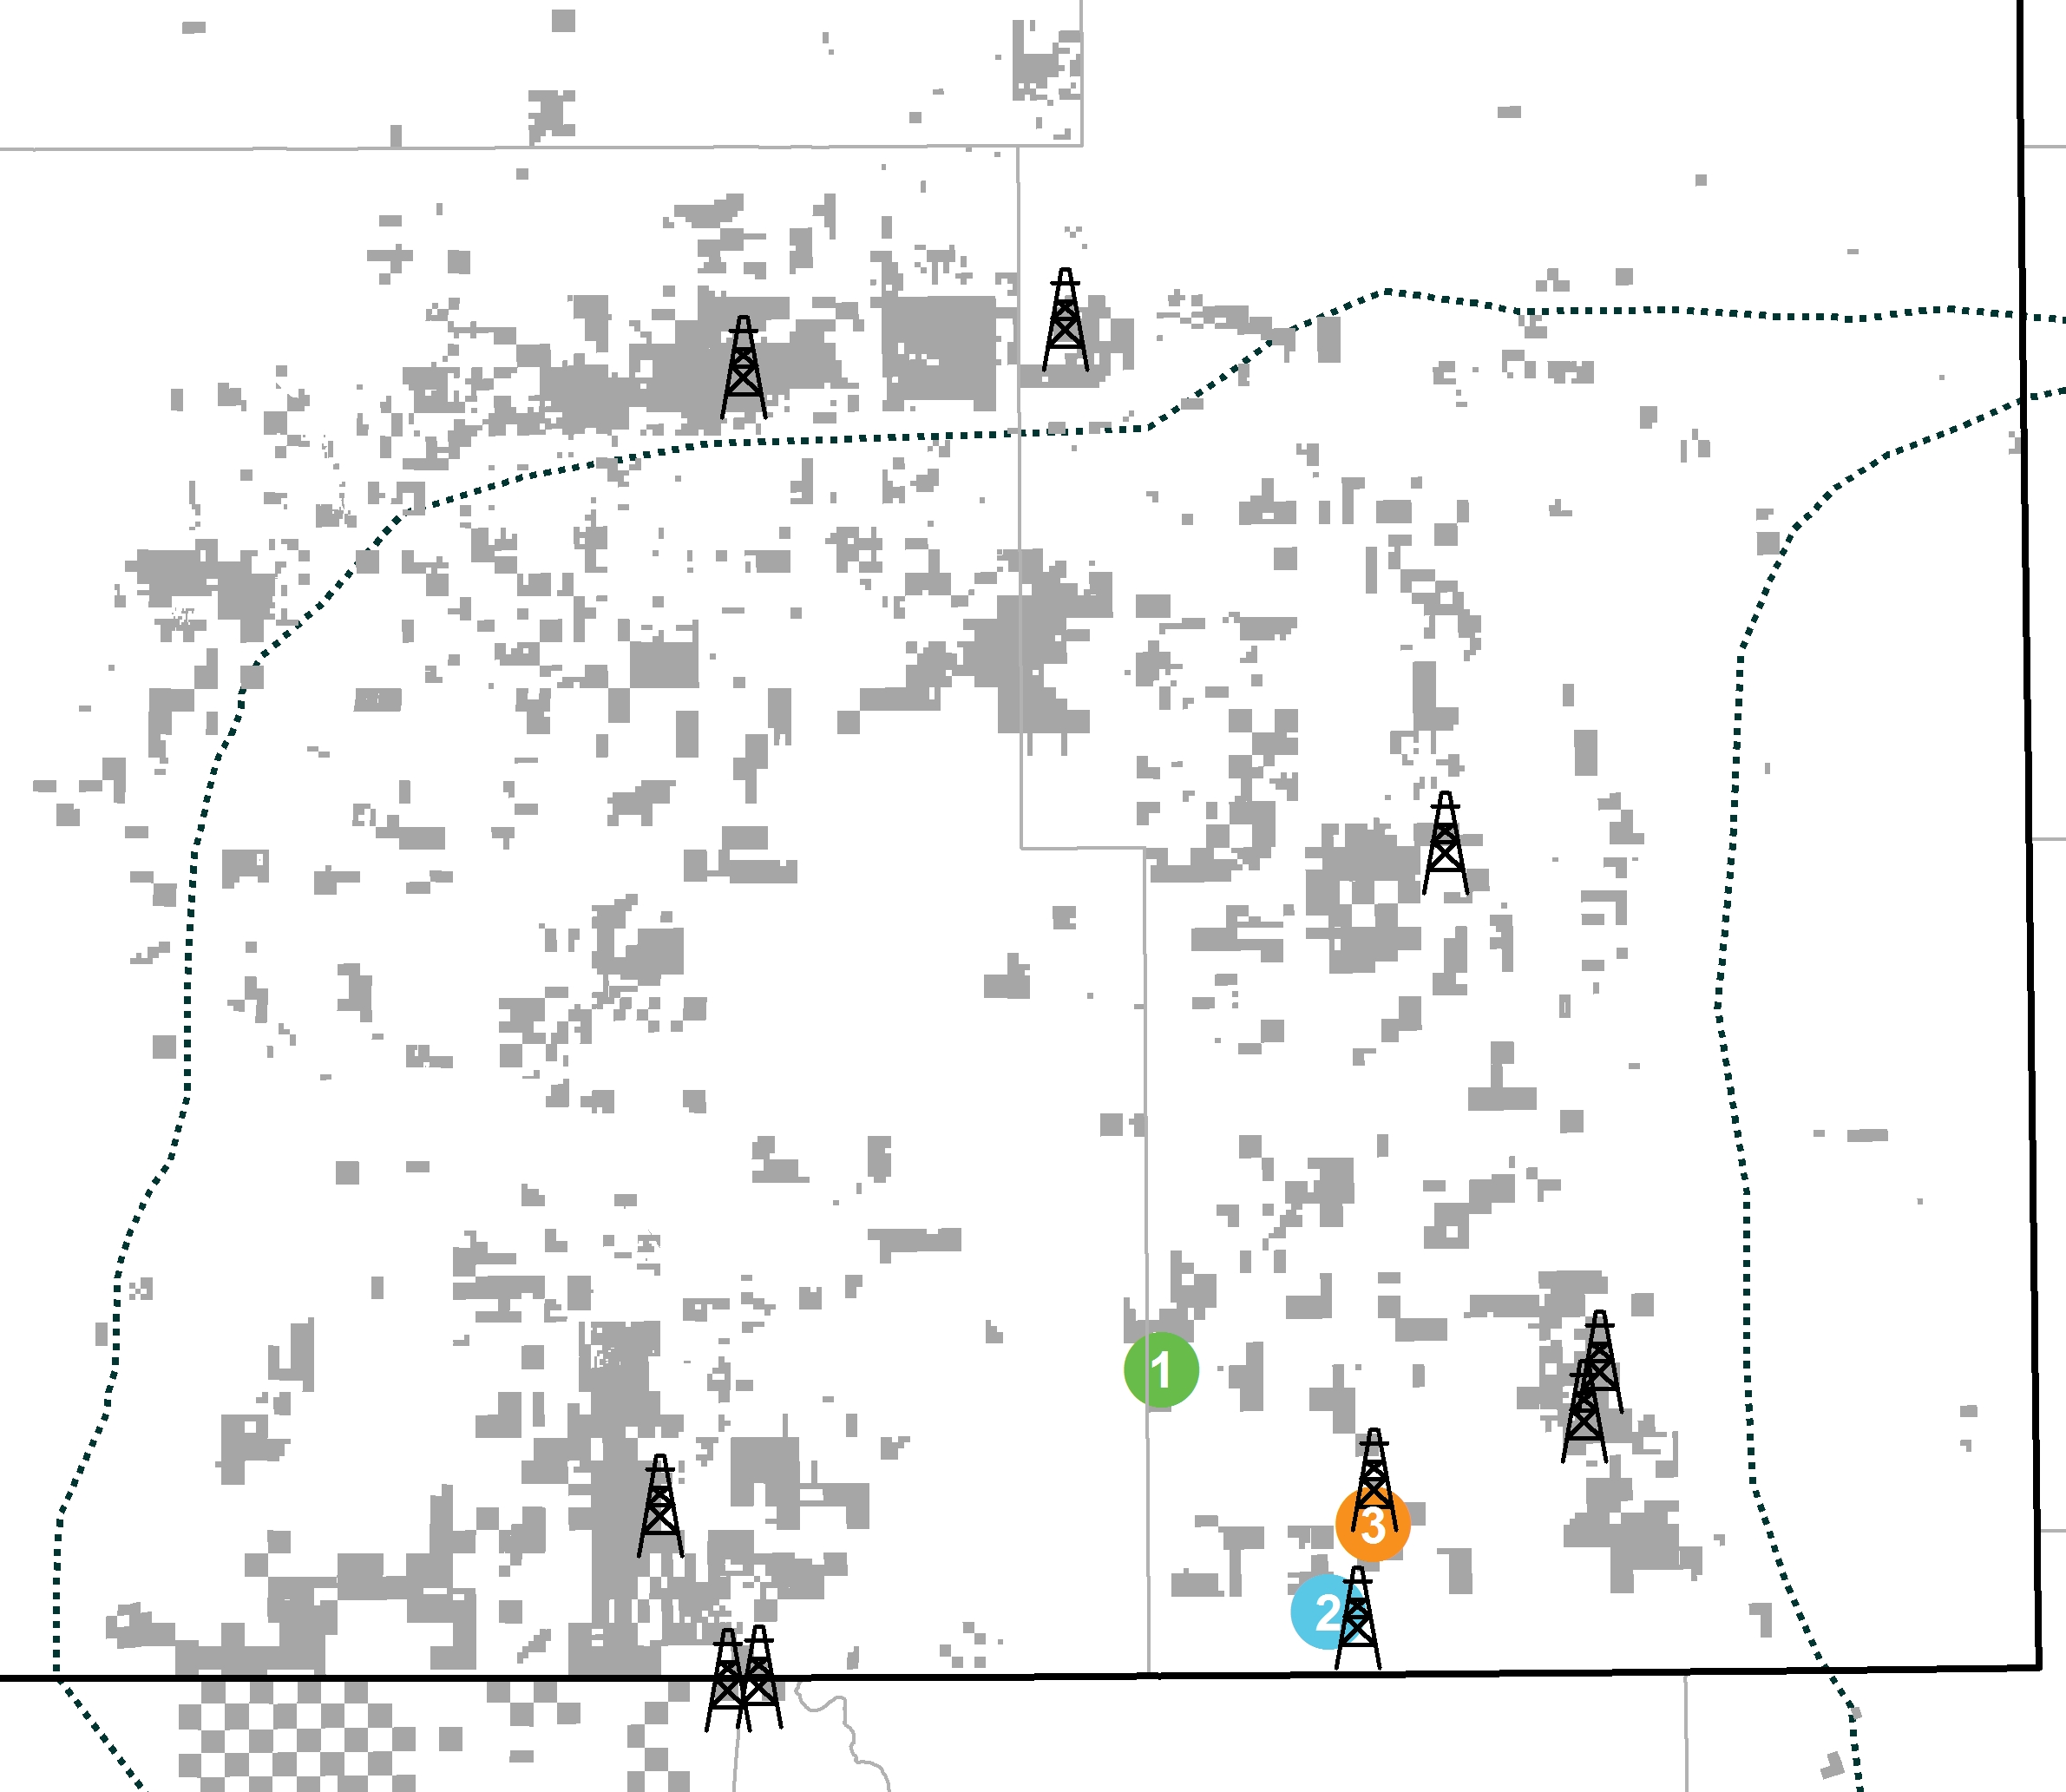
Investing Significantly in New Mexico and Lea County
Industry-Leading Exposure to Prolific Resource
New Mexico presence
Acreage: ~475,000 gross (300,000 net)
Inventory: ~11,900 horizontal drilling inventory (gross)
Rig count: 9 horizontal rigs
Regional offices in Artesia and Santa Fe
Employ approximately 350 people focused in New Mexico, a number set to grow
Chaves
CXO Acreage
LEA
Large-scale manufacturing-style development
Key to maximizing resource recovery and well economics
Current projects
Windward: 8-well, 2-mile lateral Avalon project
Vast: 7-well Wolfcamp project
Columbus: 4-well Wolfcamp project
EDDY
1
2
3
Note: Acreage as of December 31, 2016 pro forma for ~24,000 gross (16,400 net) acquisition.

Slide 6
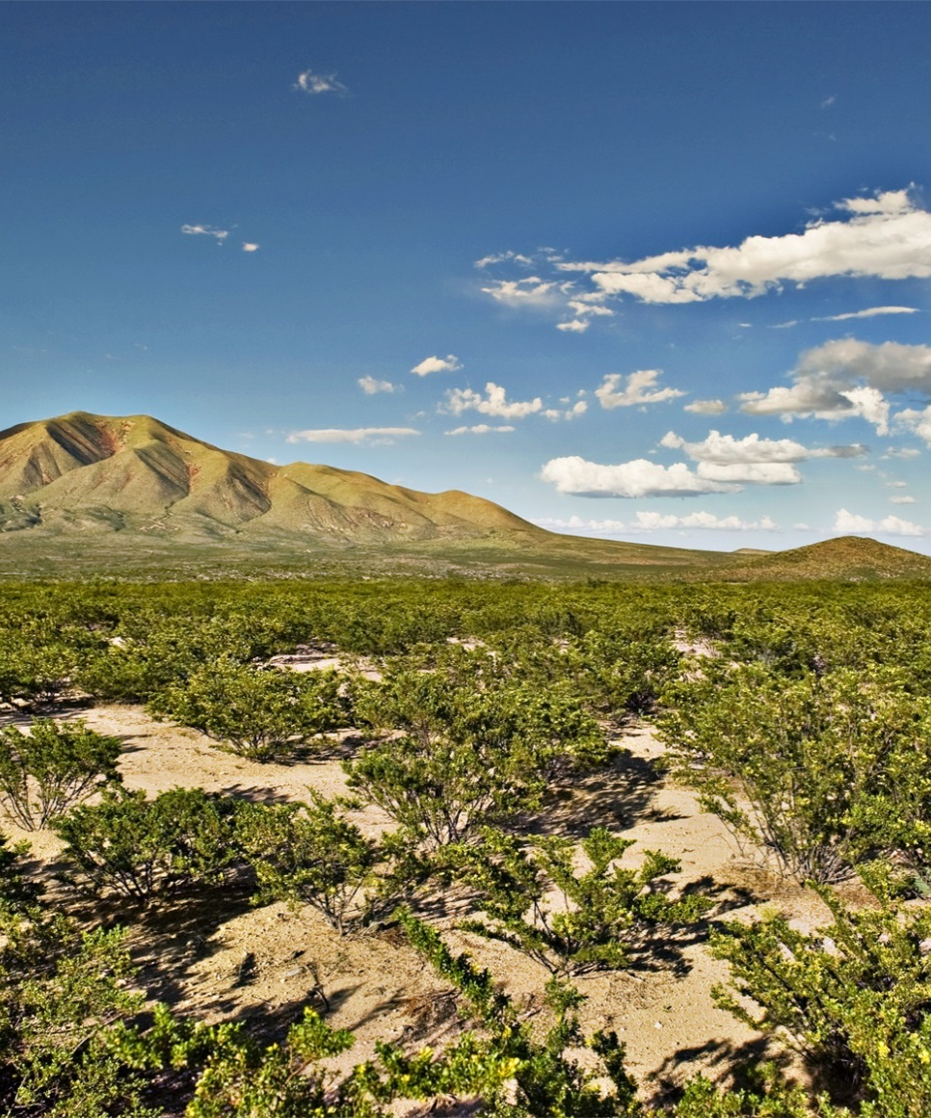
Committed to Operating Responsibly and Strengthening our Communities
Safety of our employees, our communities, and the environment are key priorities
Strive to be good stewards of resources and operate in a manner that respects people, land, water, and air
Focused on building projects in our communities to strengthen education, local arts programs, and centers
Concho has partnered with New Mexico Mathematics, Engineering, Science Achievement, Inc. to educate students on different aspects of the oil and gas industry

Slide 7
Key Messages
Executing Clear, Cycle-Tested Strategy
Disciplined Capital Allocation
Industry-Leading Scale and Execution
Hire the best
Develop the best asset base
ROR-driven
Prioritize financial strength
Capital spending on
high-ROR projects
Differentiated growth within cash flow
Robust long-term outlook
Drive productivity gains
Control costs
Leverage new technology
Mitigate risks to efficiency
Capital-Efficient Platform to Deliver Long-Term Growth & Value Creation

Slide 8
Forward-Looking Statements and Other Disclaimers
This presentation contains “forward-looking statements” within the meaning of Section 27A of the Securities Act of 1933 and Section 21E of the Securities Exchange Act of 1934. All statements, other than statements of historical fact, included in this presentation that address activities, events or developments that Concho Resources Inc. (the “Company”) expects, believes or anticipates will or may occur in the future are forward-looking statements. Forward-looking statements contained in this presentation specifically include statements, estimates and projections regarding the Company’s future financial position, operations, performance, business strategy, oil and natural gas reserves, drilling program, capital expenditure budget, liquidity and capital resources, the timing and success of specific projects, outcomes and effects of litigation, claims and disputes, derivative activities and potential financing. The words “estimate,” “project,” “predict,” “believe,” “expect,” “anticipate,” “potential,” “could,” “may,” “foresee,” “plan,” “goal” or other similar expressions that convey the uncertainty of future events or outcomes are intended to identify forward-looking statements, which generally are not historical in nature. However, the absence of these words does not mean that the statements are not forward-looking. These statements are based on certain assumptions and analyses made by the Company based on management’s experience, expectations and perception of historical trends, current conditions, anticipated future developments and other factors believed to be appropriate. Forward-looking statements are not guarantees of performance. Although the Company believes the expectations reflected in its forward-looking statements are reasonable and are based on reasonable assumptions, no assurance can be given that these assumptions are accurate or that any of these expectations will be achieved (in full or at all) or will prove to have been correct. Moreover, such statements are subject to a number of assumptions, risks and uncertainties, many of which are beyond the control of the Company, which may cause actual results to differ materially from those implied or expressed by the forward-looking statements. These include the risk factors discussed or referenced in the Company’s most recent Annual Report on Form 10-K and in the Company’s Quarterly Report on Form 10-Q for the quarter ended March 31, 2017; risks relating to declines in, or the sustained depression of, the prices the Company receives for its oil and natural gas; uncertainties about the estimated quantities of oil and natural gas reserves; drilling, completion and operating risks; the effects of government regulation, permitting and other legal requirements, including new legislation or regulation of hydraulic fracturing and the export of oil and natural gas; environmental hazards, such as uncontrollable flows of oil, natural gas, brine, well fluids, toxic gas or other pollution into the environment, including groundwater contamination; difficult and adverse conditions in the domestic and global capital and credit markets; risks related to the concentration of the Company’s operations in the Permian Basin of Southeast New Mexico and West Texas; disruptions to, capacity constraints in or other limitations on the pipeline systems that deliver the Company’s oil, natural gas liquids and natural gas and other processing and transportation considerations; the costs and availability of equipment, resources, services and qualified personnel required to perform the Company’s drilling and operating activities; potential financial losses or earnings reductions from the Company’s commodity price risk-management program; risks and liabilities associated with acquired properties or businesses; uncertainties about the Company’s ability to successfully execute its business and financial plans and strategies; the adequacy of the Company’s capital resources and liquidity including, but not limited to, access to additional borrowing capacity under the Company’s credit facility; the impact of potential changes in the Company’s credit ratings; cybersecurity risks, such as those involving unauthorized access, malicious software, data privacy breaches by employees or others with authorized access, cyber or phishing-attacks, ransomware and other security issues; uncertainties about the Company’s ability to replace reserves and economically develop its current reserves; general economic and business conditions, either internationally or domestically; competition in the oil and natural gas industry; uncertainty concerning the Company’s assumed or possible future results of operations; and other important factors that could cause actual results to differ materially from those projected.
The Securities and Exchange Commission (“SEC”) requires oil and natural gas companies, in their filings with the SEC, to disclose proved reserves, which are those quantities of oil and natural gas, which, by analysis of geoscience and engineering data, can be estimated with reasonable certainty to be economically producible—from a given date forward, from known reservoirs, and under existing economic conditions (using the trailing 12-month average first-day-of-the-month prices), operating methods, and government regulations—prior to the time at which contracts providing the right to operate expire, unless evidence indicates that renewal is reasonably certain, regardless of whether deterministic or probabilistic methods are used for the estimation. The SEC also permits the disclosure of separate estimates of probable or possible reserves that meet SEC definitions for such reserves; however, the Company currently does not disclose probable or possible reserves in its SEC filings.
In this presentation, proved reserves attributable to the Company at December 31, 2016 are estimated utilizing SEC reserve recognition standards and pricing assumptions based on the trailing 12-month average first-day-of-the-month prices of $39.25 per Bbl of oil and $2.48 per MMBtu of natural gas. The Company’s estimate of its total proved reserves at December 31, 2016 is based on reports prepared by Cawley, Gillespie & Associates, Inc. and Netherland, Sewell & Associates, Inc., independent petroleum engineers. The Company may use the terms “unproved reserves,” “resource potential,” “EUR” per well, “upside potential” and “prospective acreage” to describe estimates of potentially recoverable hydrocarbons that the SEC rules prohibit from being included in filings with the SEC. These are based on analogy to the Company’s existing models applied to additional acres, additional zones and tighter spacing and are the Company’s internal estimates of hydrocarbon quantities that may be potentially discovered through exploratory drilling or recovered with additional drilling or recovery techniques. These quantities may not constitute “reserves” within the meaning of the Society of Petroleum Engineer’s Petroleum Resource Management System or SEC rules. EUR estimates, resource potential and identified drilling locations have not been fully risked by Company management and are inherently more speculative than proved reserves estimates. Actual locations drilled and quantities that may be ultimately recovered from the Company’s interests could differ substantially. There is no commitment by the Company to drill all of the drilling locations, which have been attributed to these quantities. Factors affecting ultimate recovery include the scope of the Company’s ongoing drilling program, which will be directly affected by the availability of capital, drilling and production costs, availability of drilling services and equipment, drilling results, lease expirations, transportation constraints, regulatory approvals, actual drilling results, including geological and mechanical factors affecting recovery rates, and other factors. Estimates of unproved reserves, resource potential, per well EUR and upside potential may change significantly as development of the Company’s oil and natural gas assets provide additional data. The Company’s production forecasts and expectations for future periods are dependent upon many assumptions, including estimates of production decline rates from existing wells and the undertaking and outcome of future drilling activity, which may be affected by significant commodity price declines or drilling cost increases.

