Slide 1
Energy Forum Brief
June 27, 2017
Presented by
Matt White
Mayor, City of Eunice
citymayor@cityofeunice.org
Martin Moore
City Manager, City of Eunice
manager@cityofeunice.org
575-394-2576

Slide 2
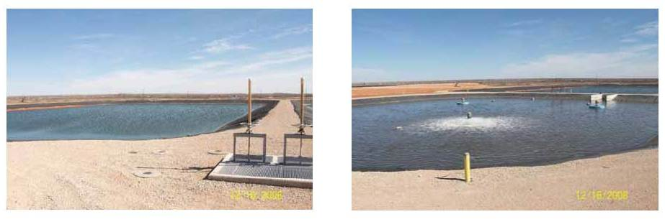
Waste water plant
Old M-Hoff system, built in 1949
New Plant - $8 million has aerated lagoons, completed in 2011
LES built a sewer line (High Pressure) from plant - $1.5 million, donated to the City
City put in a sewer line 3 miles to the east for future development $375,000

Slide 3
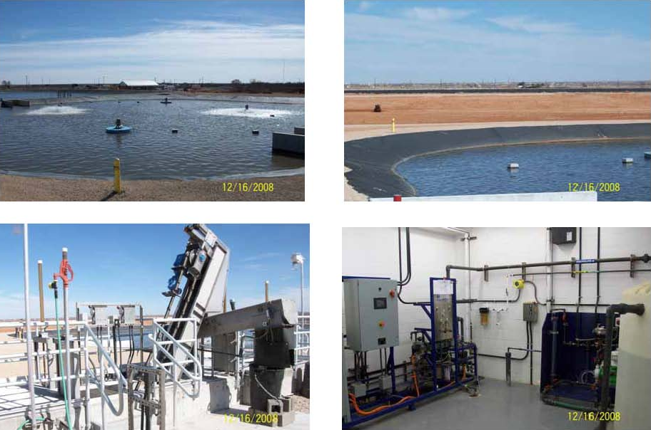

Slide 4
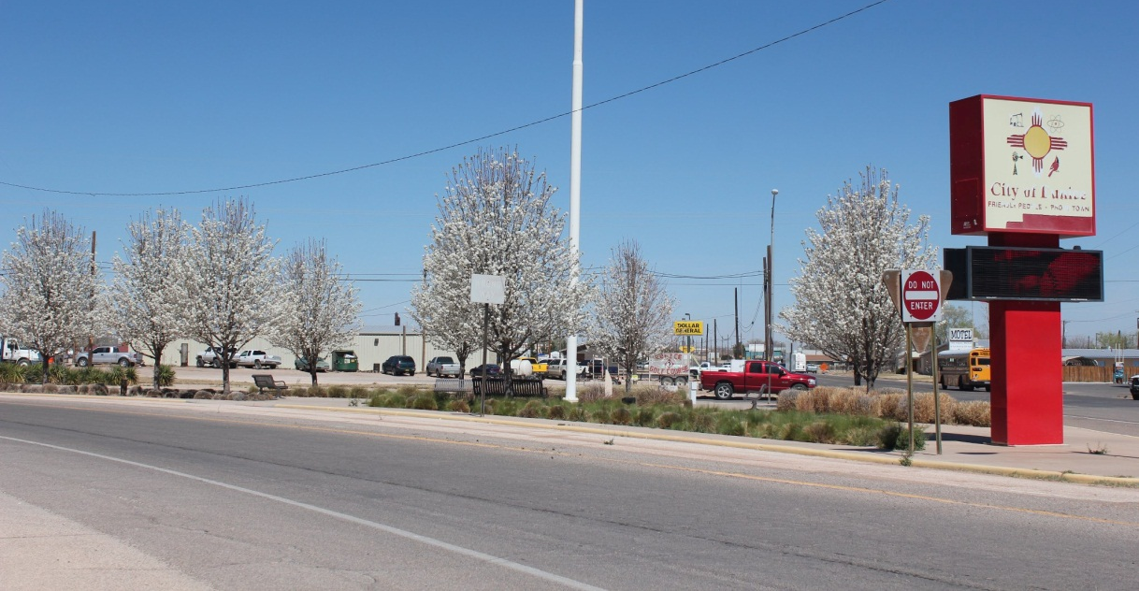
Downtown Beautification
To attract new investors and people
City acquired 1 acre in middle of Town for New Park and Civic Center
Finished 5th phase of construction 2014 $1 million
Completed Flag Welcome Area
$375,000
First of 5 phases - $4.5 million

Slide 5
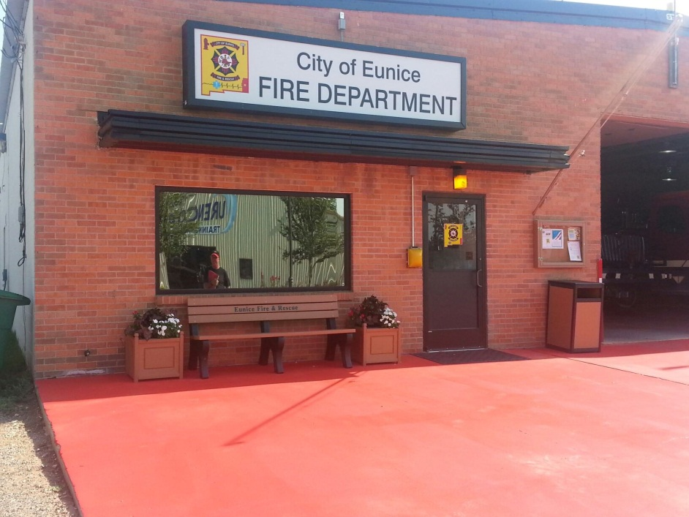
Emergency services
Replaced 5 trucks
$1.250,000
Replaced 3 Ambulances $450,000
Building 2nd Station-2016
Must meet LES’s Emergency Action Plan
First Responder for LES/WCS/Oil Field
Area covers 1000 sq. miles
3 full time/30 volunteer’s

Slide 6
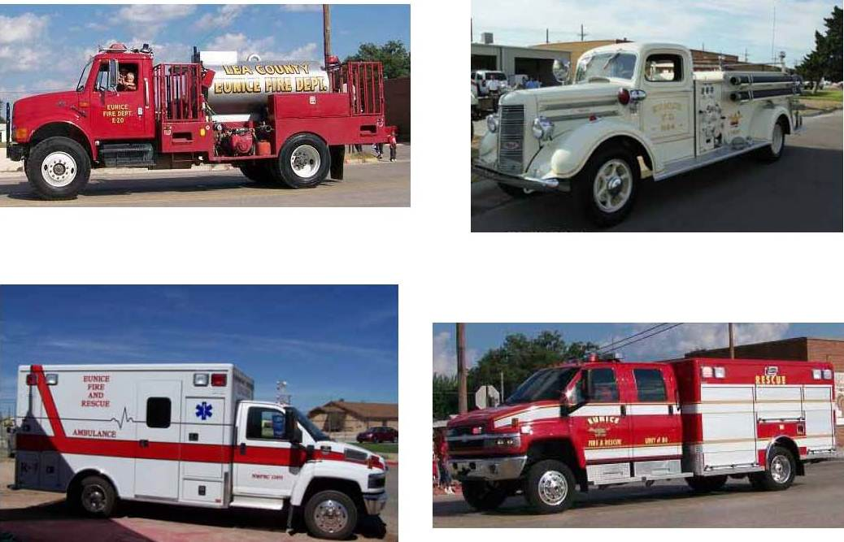

Slide 7
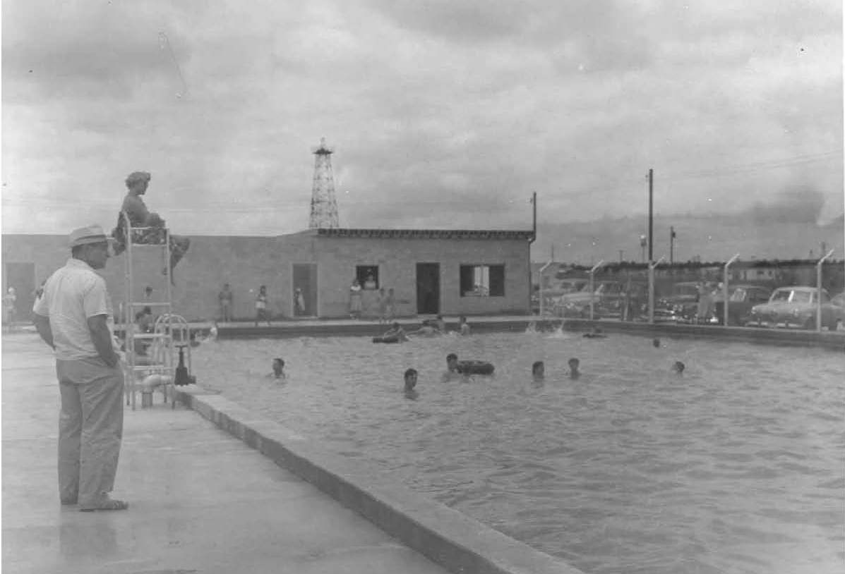
City Pool Built in 40’s

Slide 8
New aquatic facility and skate park
$2.5 million total
$1 million from State
$350,000 from Grants
$100,000 from donations
$1 million from City savings account

Slide 9
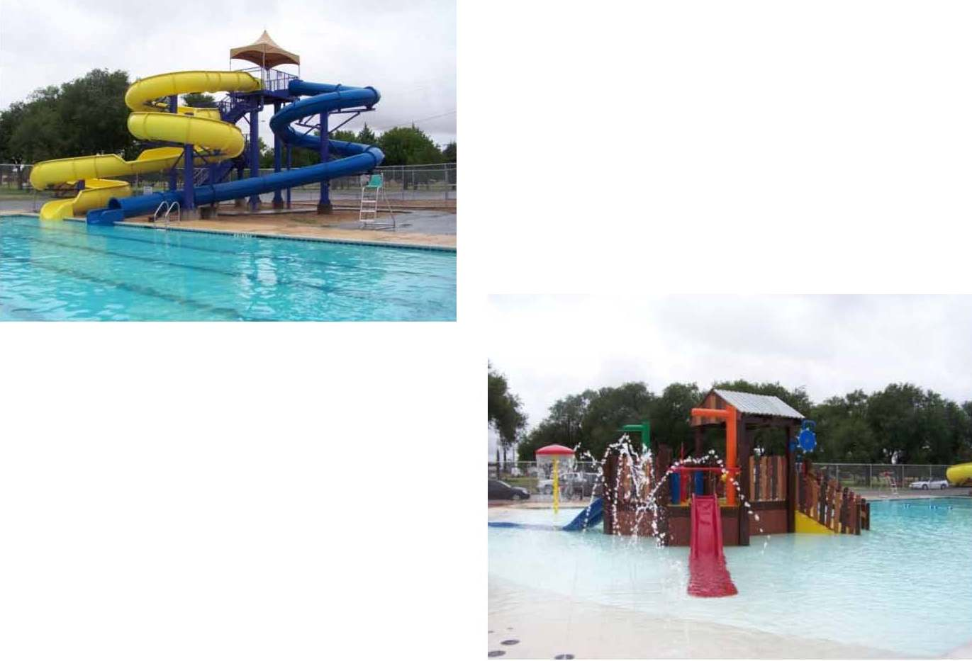

Slide 10
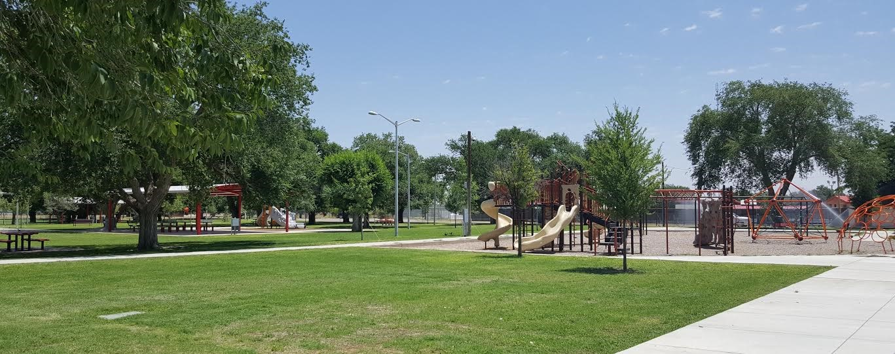
Marshall Park Project 2017
Funded by the JF Maddox Foundation, Lea County and the
Community Foundation of URENCO-USA
Several new pavilions, trees, sidewalks, entry ways to the park and nice green grass

Slide 12
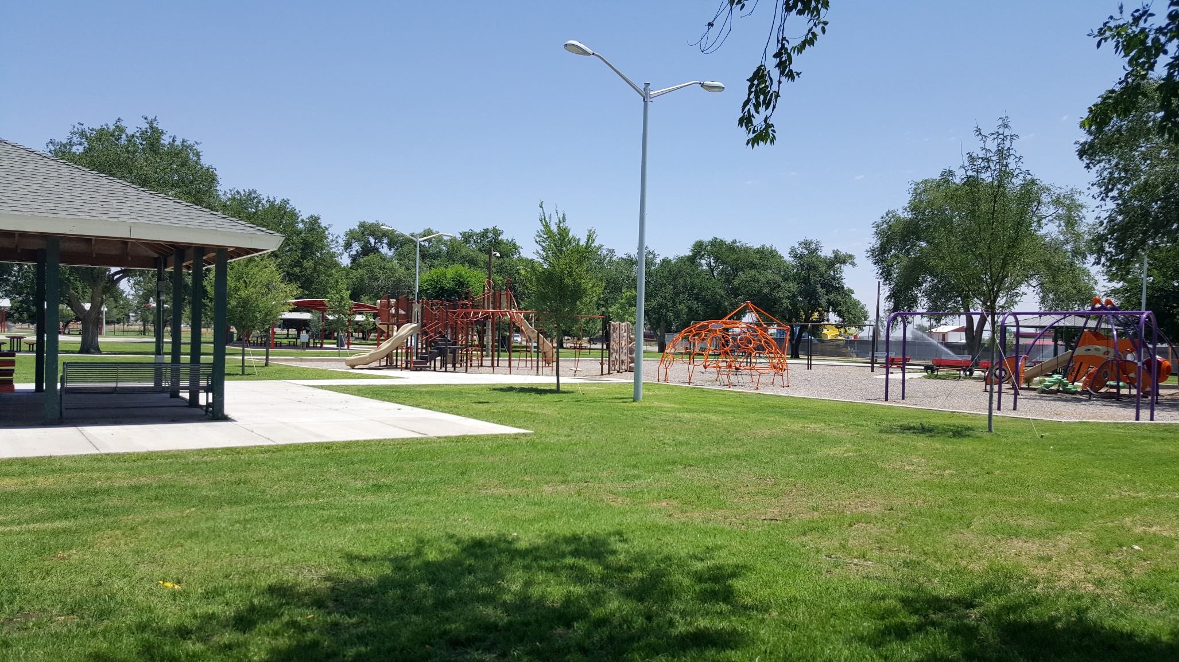

Slide 13
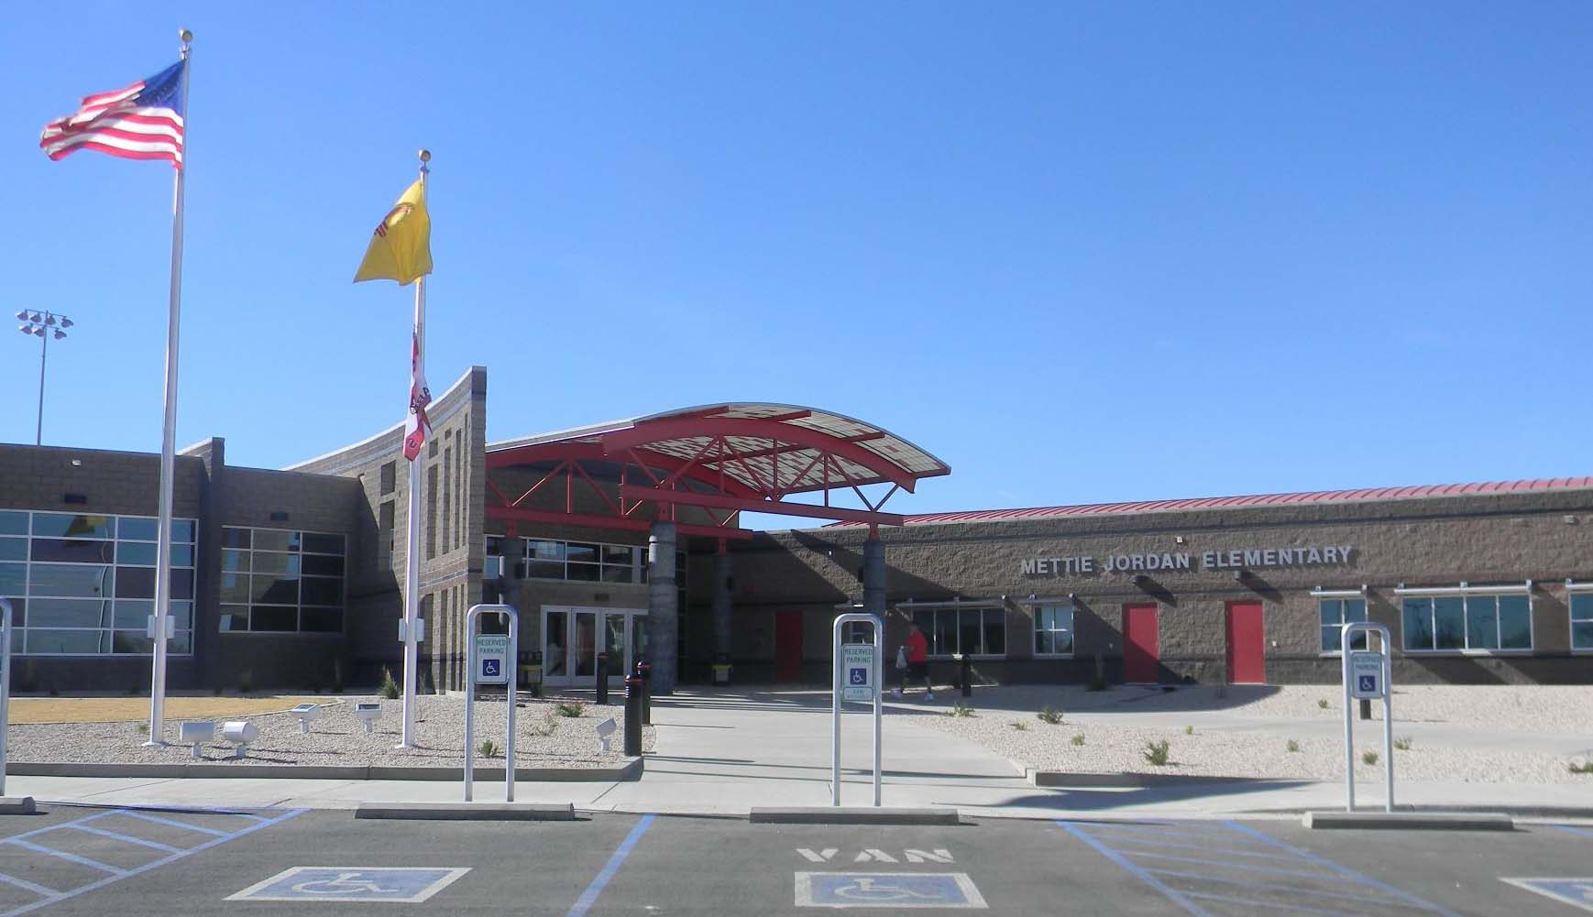
Mettie Jordan Elementary School

Slide 14
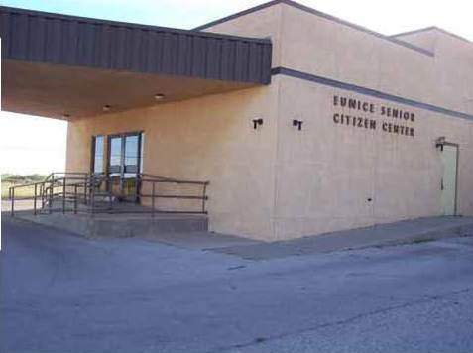
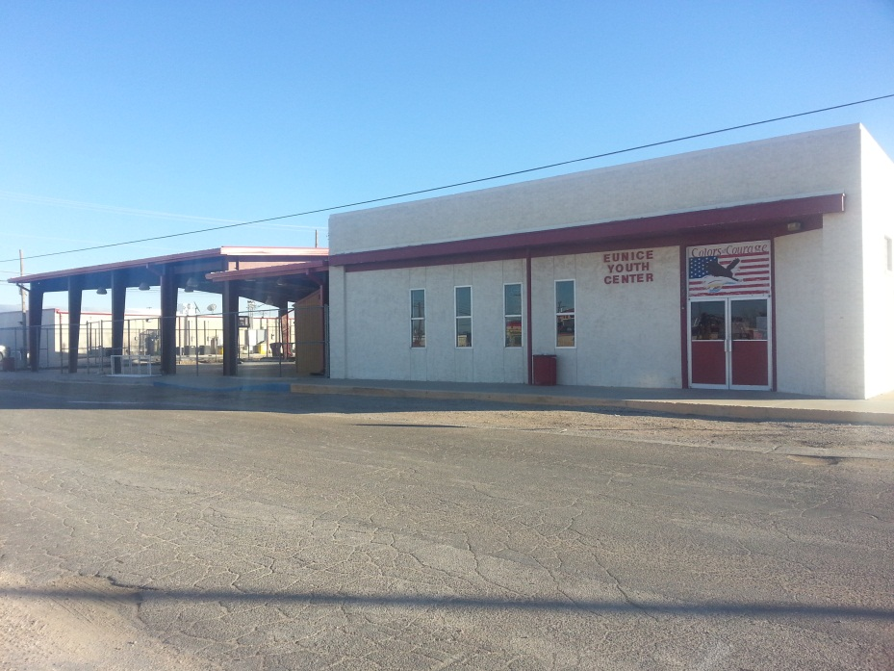
Other Improvement
Projects
*Improve Youth/Teen Center-$250,000
*Open 3 days a week
*From 50 to 75 kids
a day
*No other place to go
*Senior Center Expansion $305,000
*Feed an average of
60-90 seniors a day
*Home bounds 35-40 a day

Slide 15
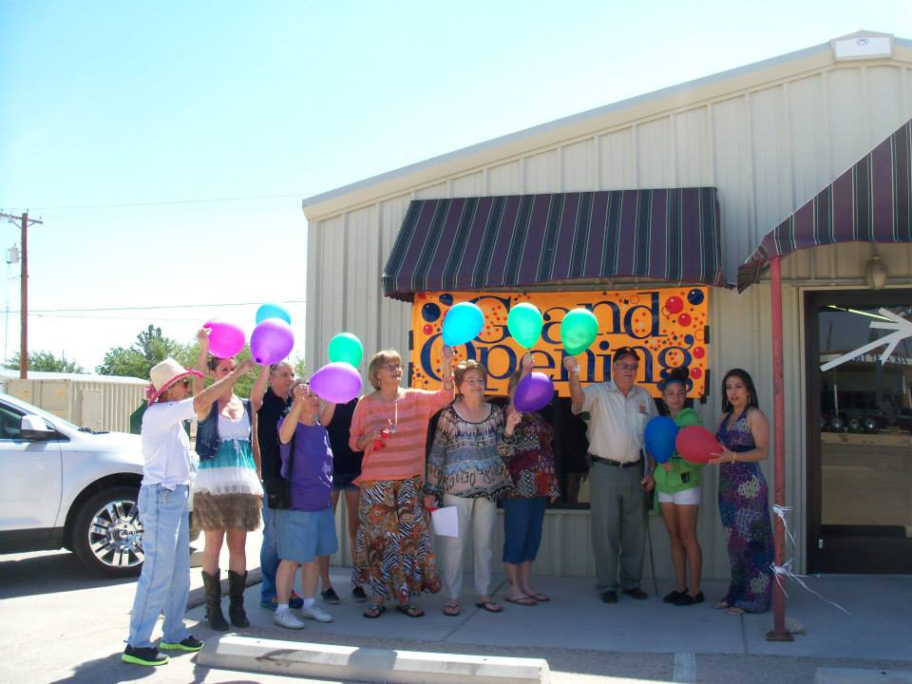
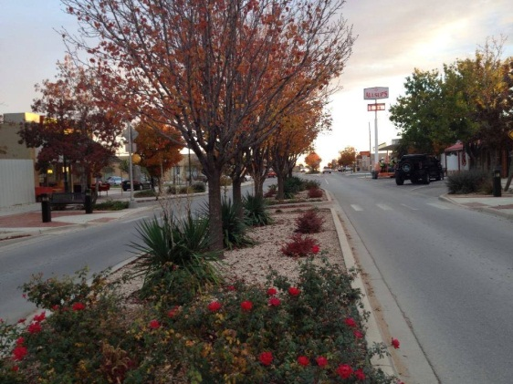
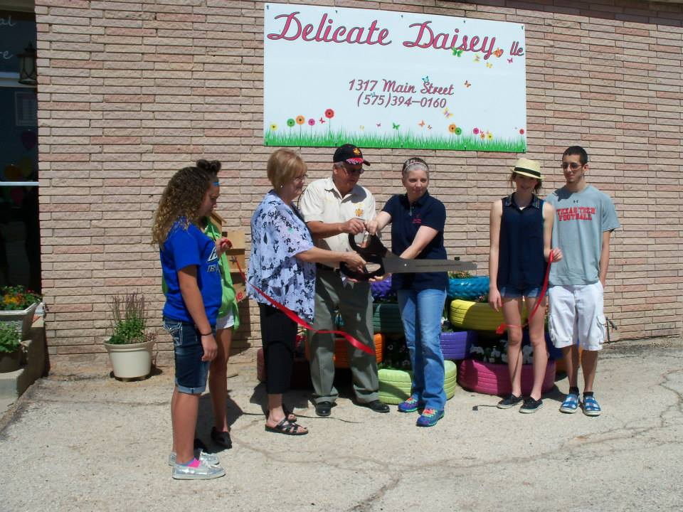
FUTURE PROJECTS
Continue Downtown Beautification
New Police/Court Facility
Rodeo Arena
Substation for Fire Department
Sewer Line Replacement
LOVES Truck Stop
Repair to City streets

Slide 16
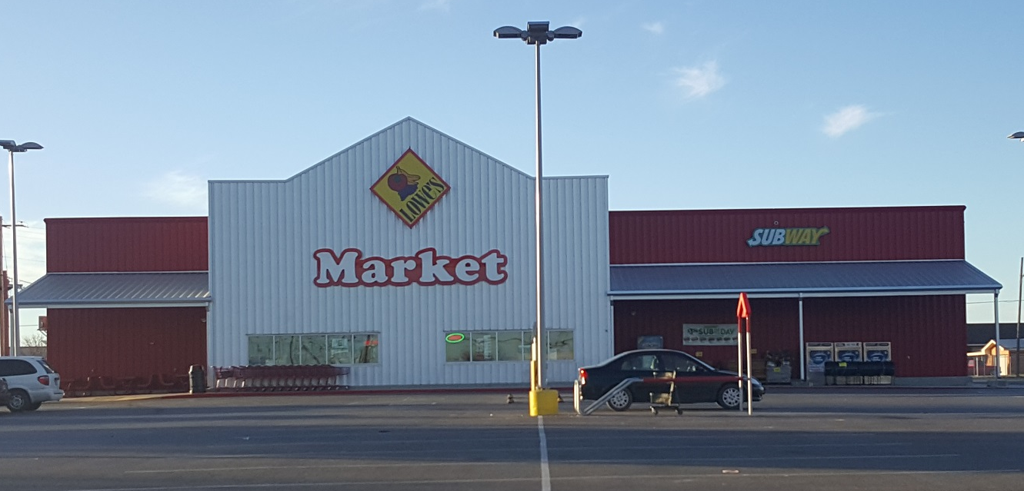
New Lowes Grocery Store
Having to enlarge
To keep up with demand
Opened in May 2014
New Pharmacy
Opened in March 2014

Slide 17
Motor Vehicle Department/Public Works Office
Community Center –new parking lot and landscaping

Slide 18
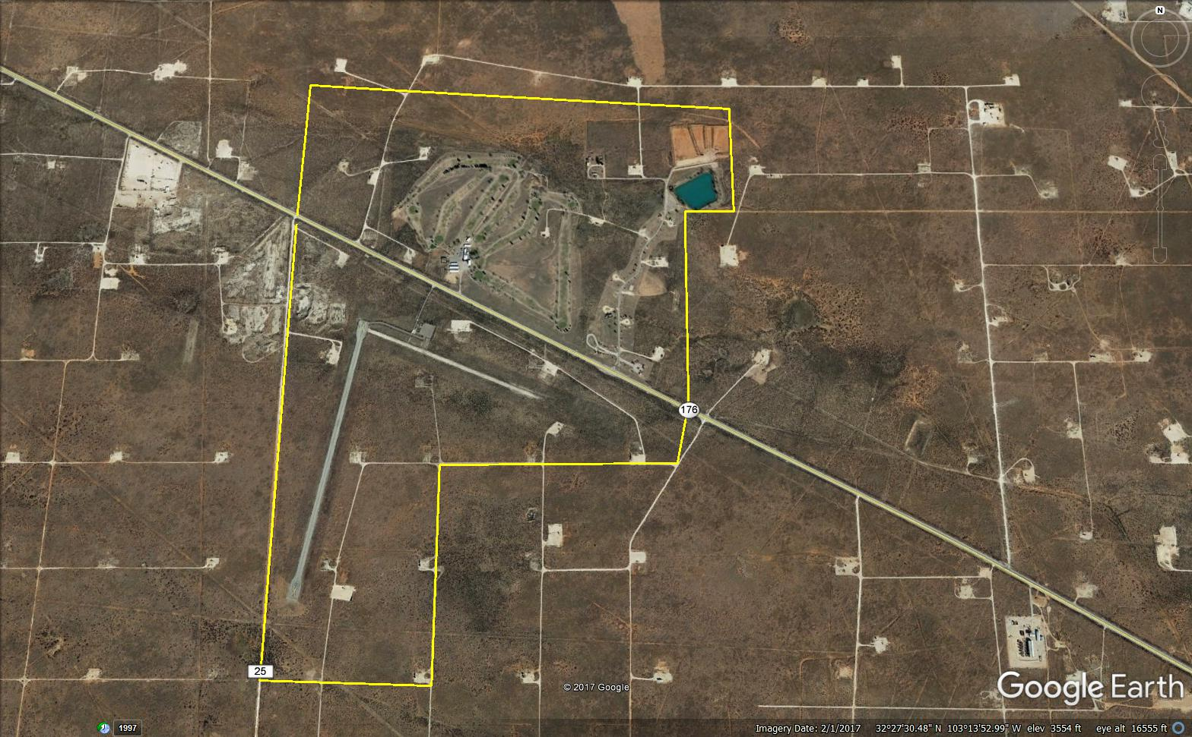
240 acres, located across from the
Eunice Municipal Golf Course

Slide 19
Nadine Water Station
Located 3 miles west of 18 on Billy Walker Road

Slide 20
QUESTIONS

